Slide 1
3d pose estimation via point pair features ın opencv
Tolga Birdal
GSoC 2014

Slide 2

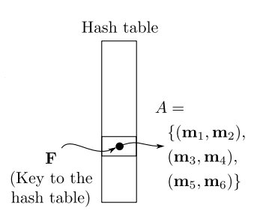
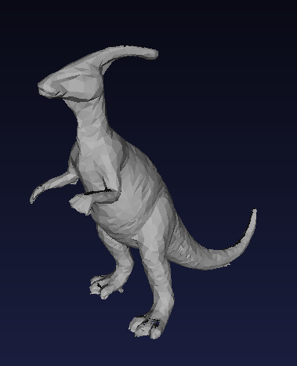
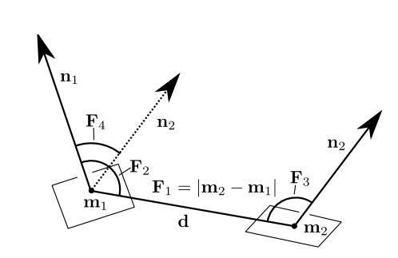
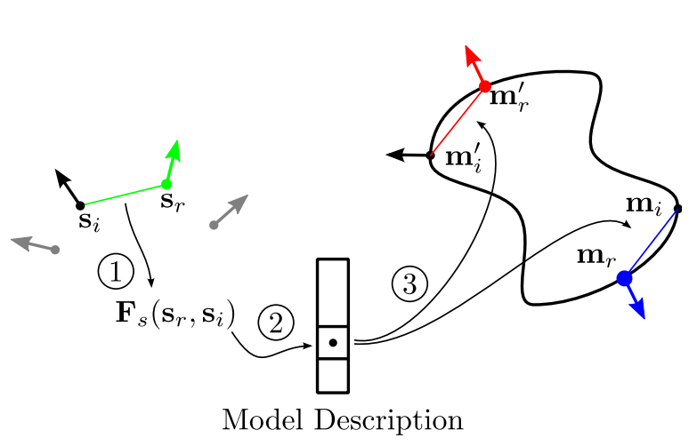
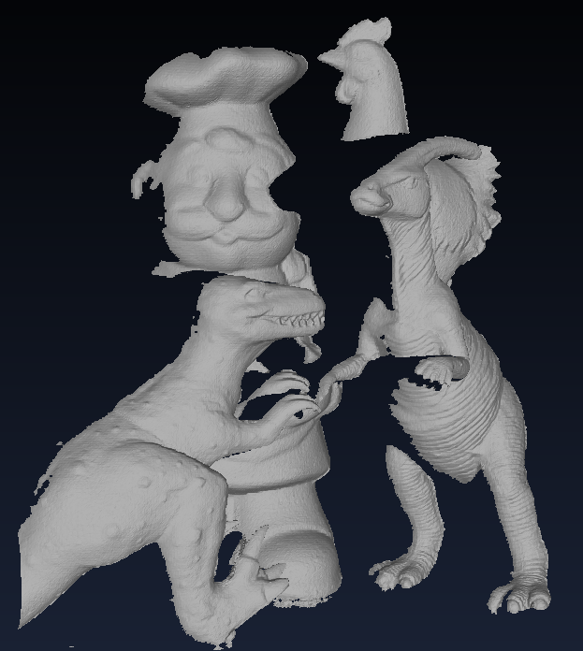
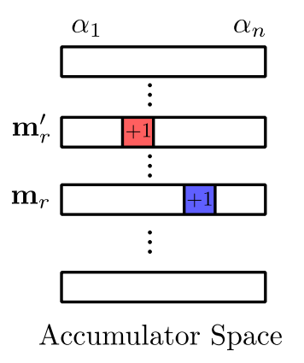
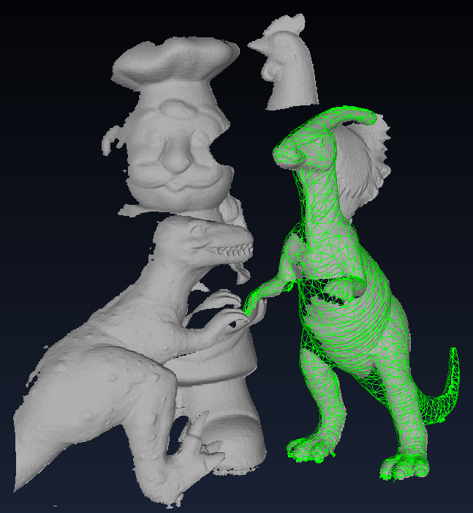
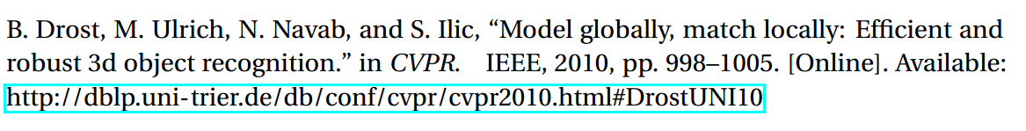
outline of the algorithm
PPF Feature Extraction
Compute Hashtable & Precompute α_{model}
Trained Model
Load / Generate 3D Model
Training
Runtime
Hashtable Lookup & Vote for Pose
Pose Clustering
Load / Generate 3D Model
ICP Refinement & Final Pose

Slide 3
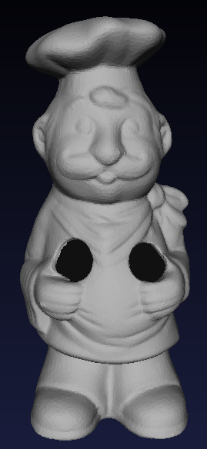
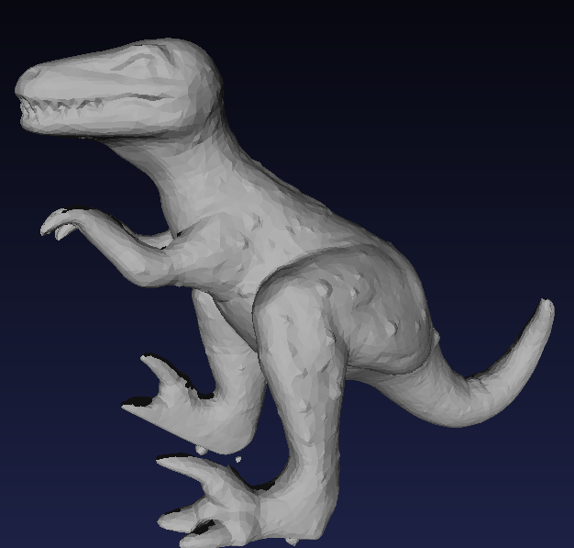
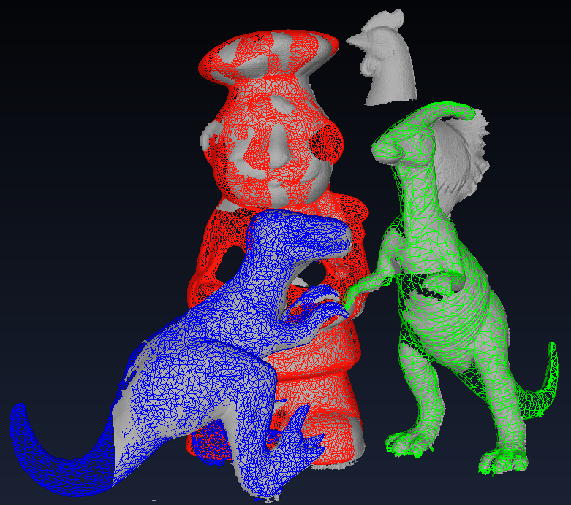
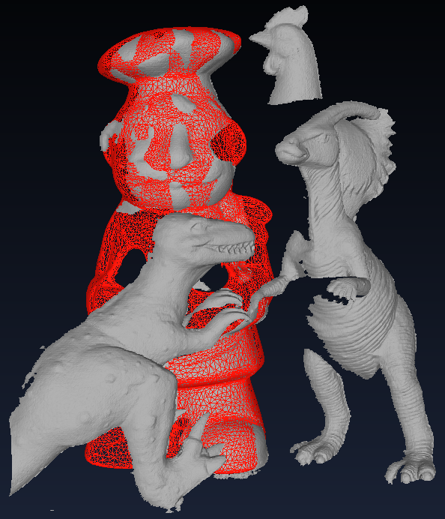
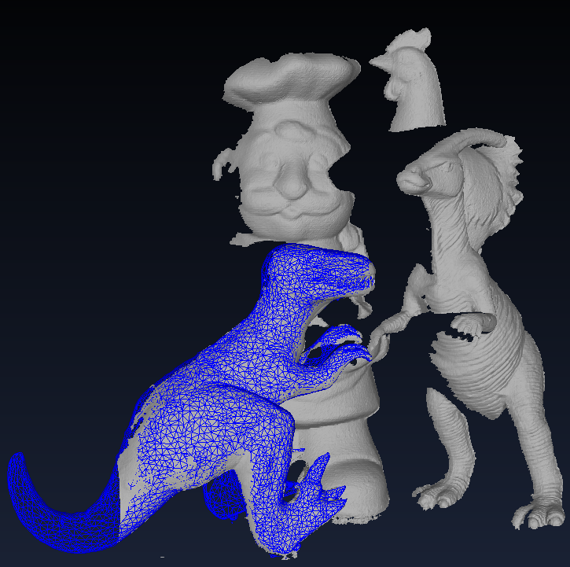
Registration using point pair features - LASER
Input 3D Models
PPF + ICP
All Models
Full Pose Estimation
Input 3D Scene
Registrations

Slide 4
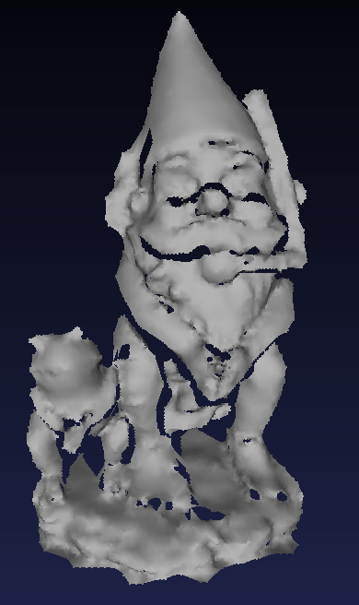
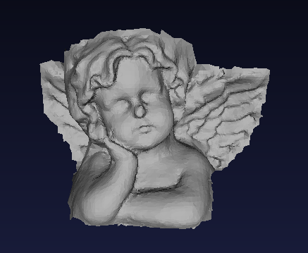
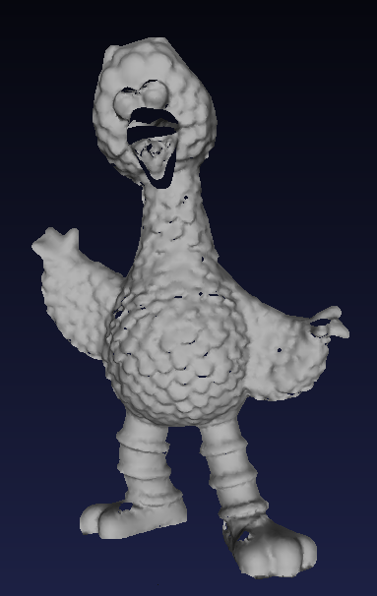
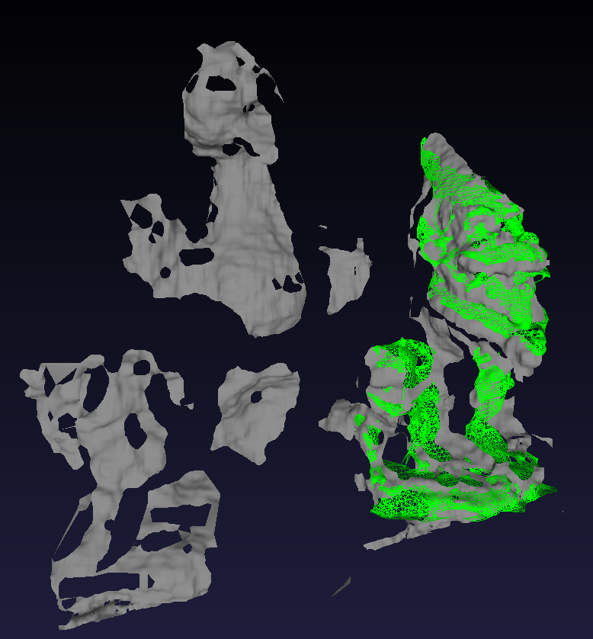
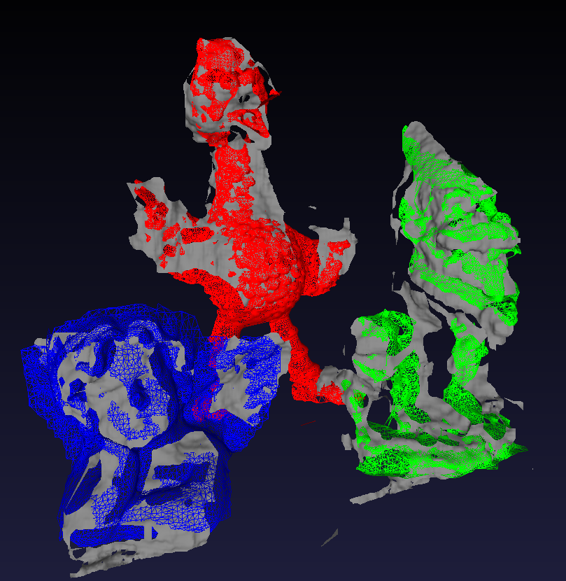
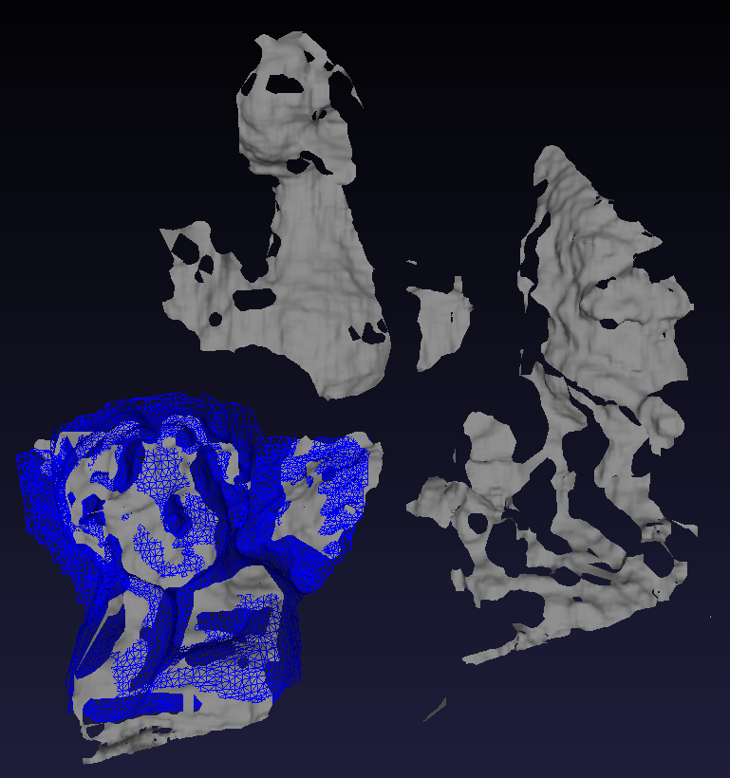
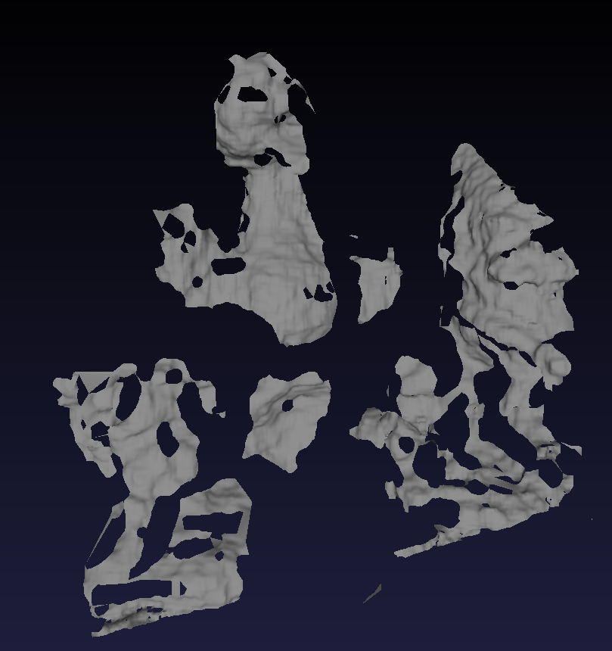
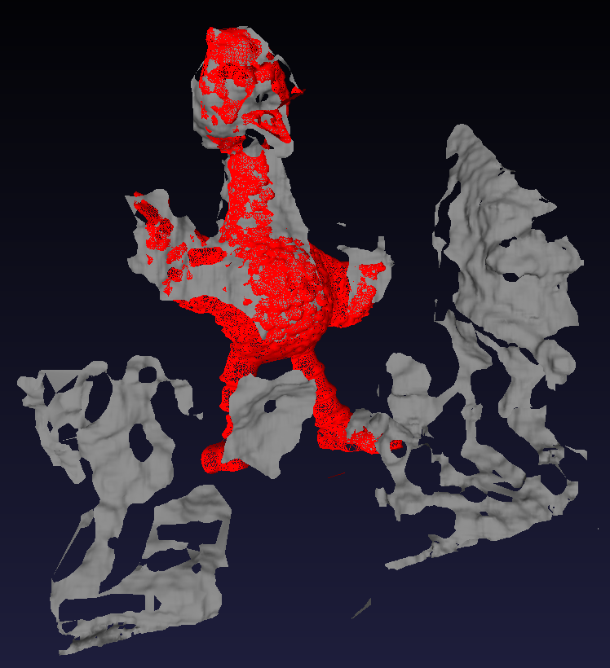
Registration using point pair features - STEREO
Input 3D Models
PPF + ICP
All Models
Input 3D Scene
Registrations

Slide 5
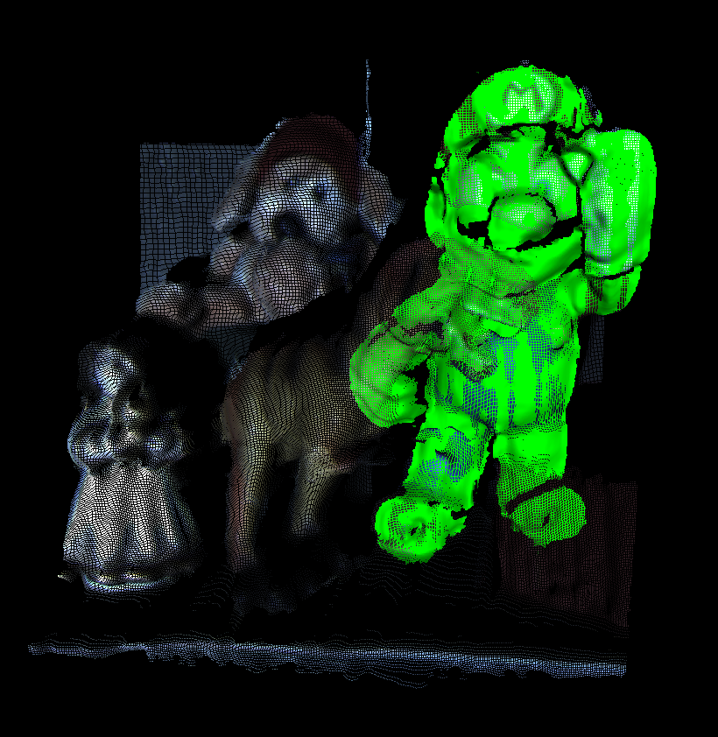

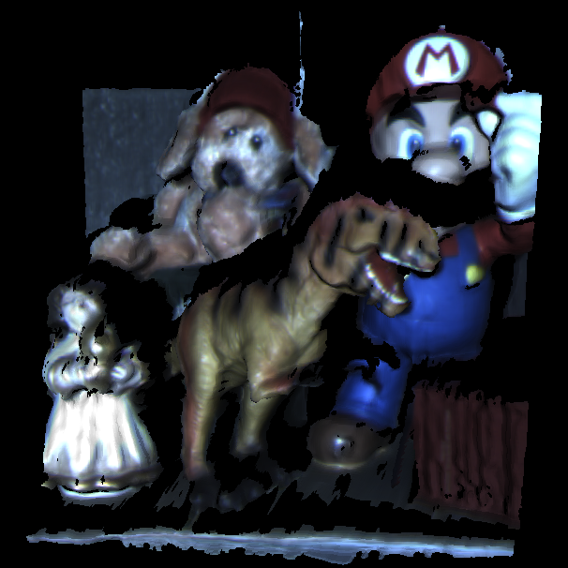

Regıstratıon on spacetime stereo
Dataset from http://vision.deis.unibo.it/keypoints3d/?page_id=2
Model
Scene
Registered Pose

Slide 6
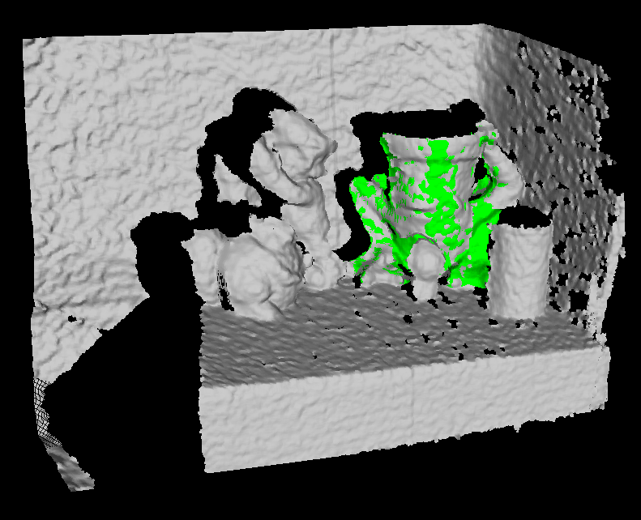
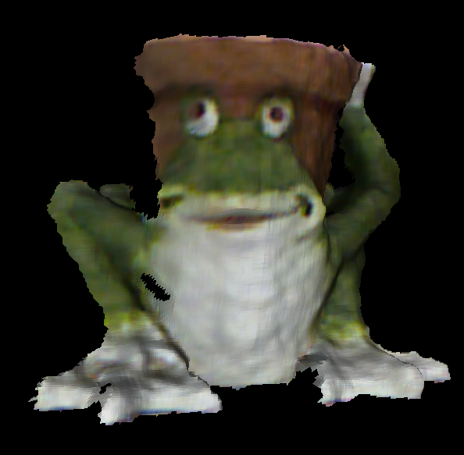
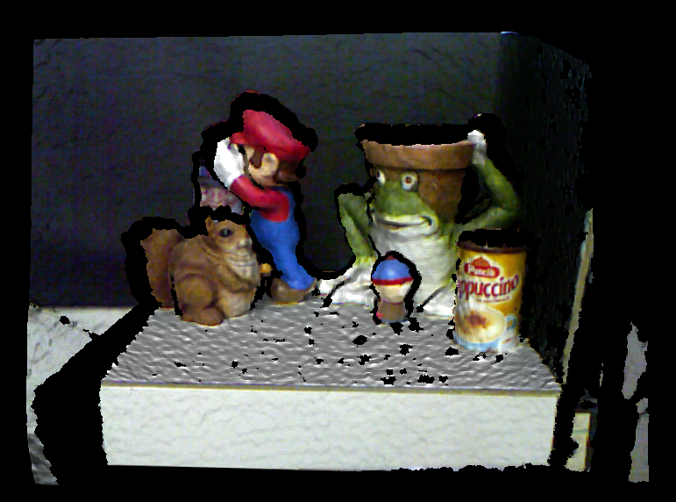
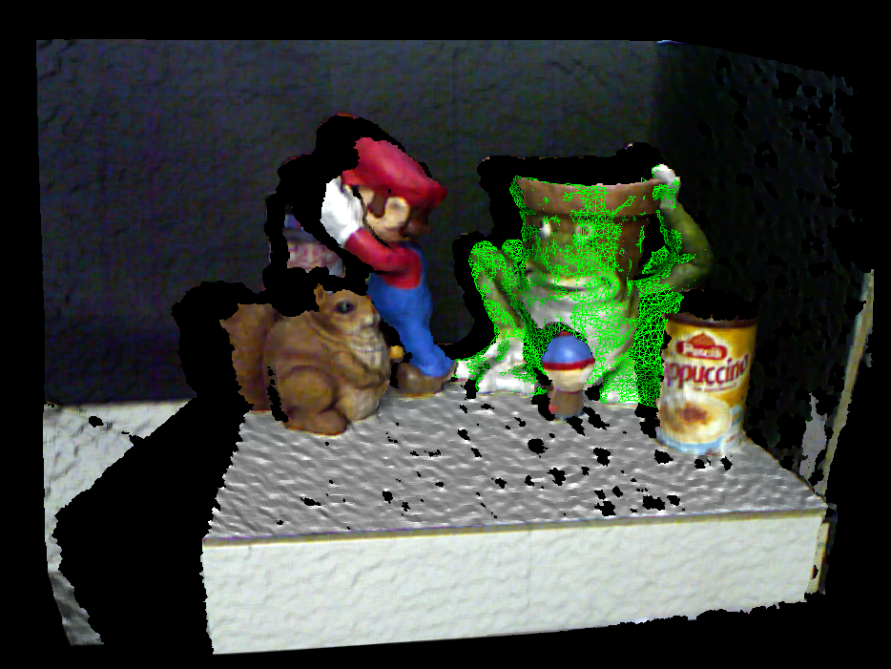
Regıstratıon on kinect
Dataset from http://vision.deis.unibo.it/keypoints3d/?page_id=2
Model
Scene
Registered Pose

Slide 7
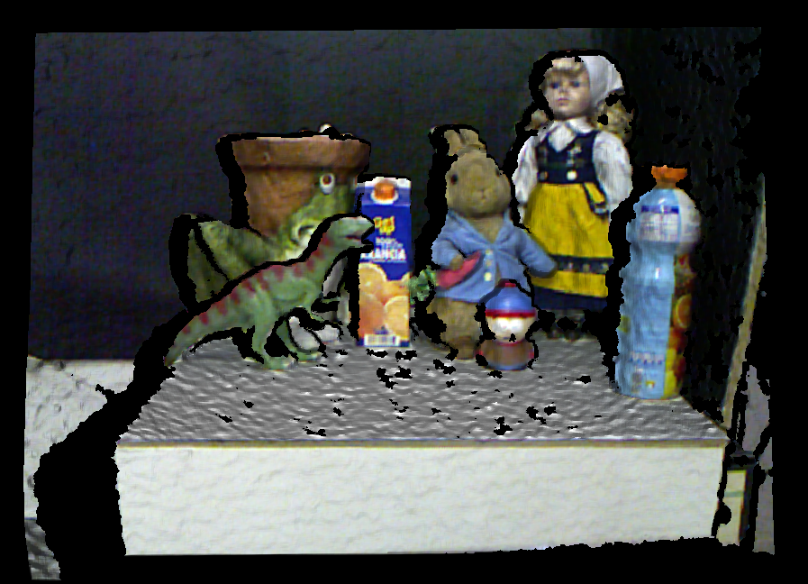
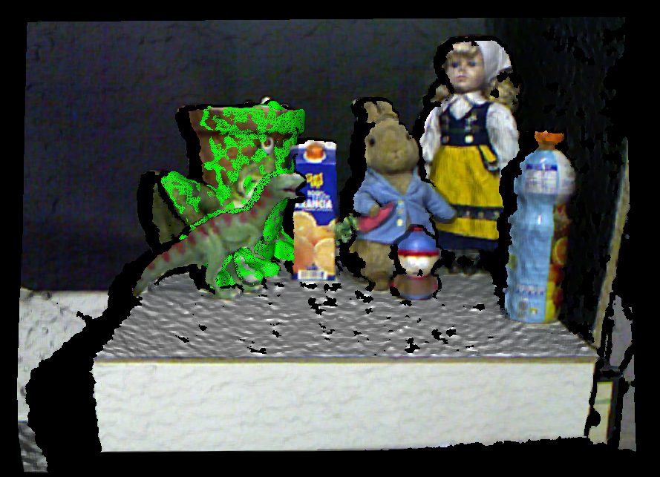
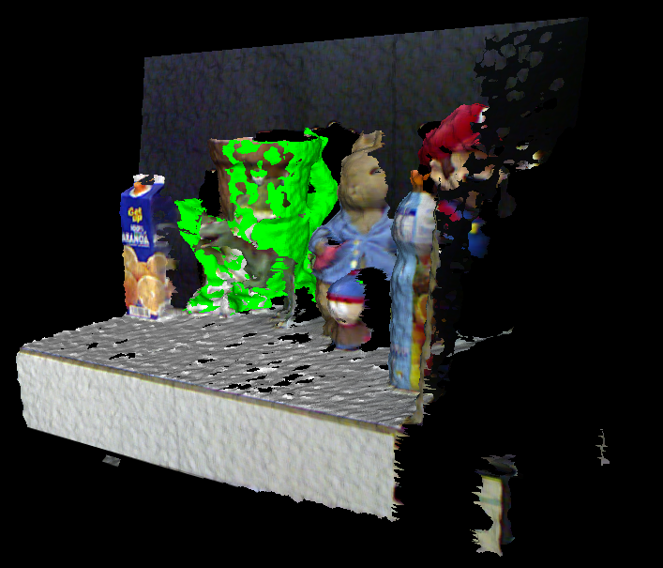
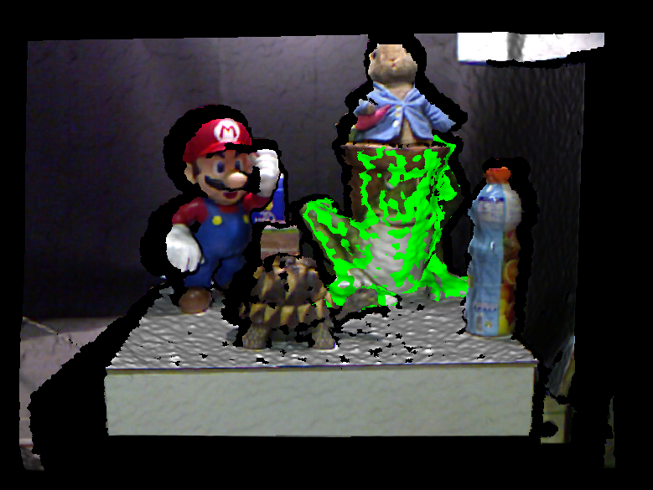
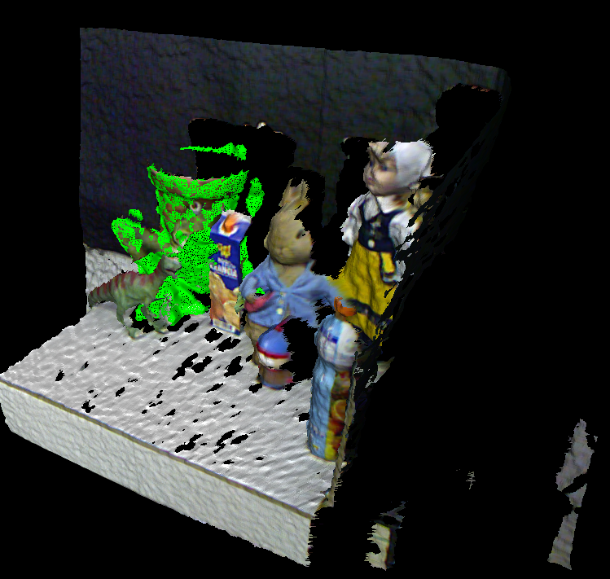
Regıstratıons on kinect
Scene
Registered Pose
Model
PPF + ICP

Slide 8
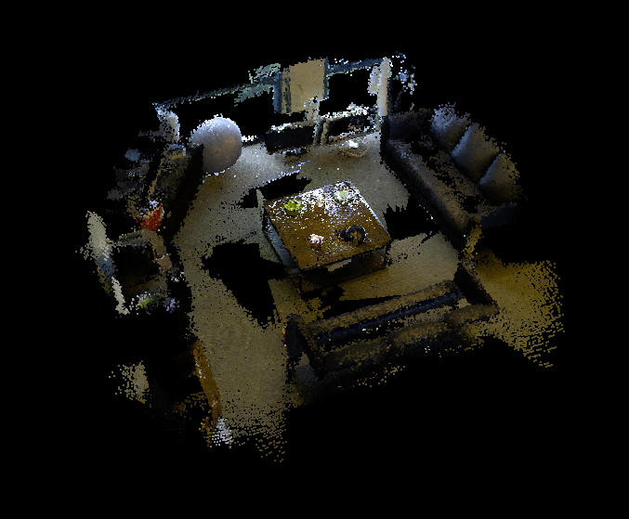
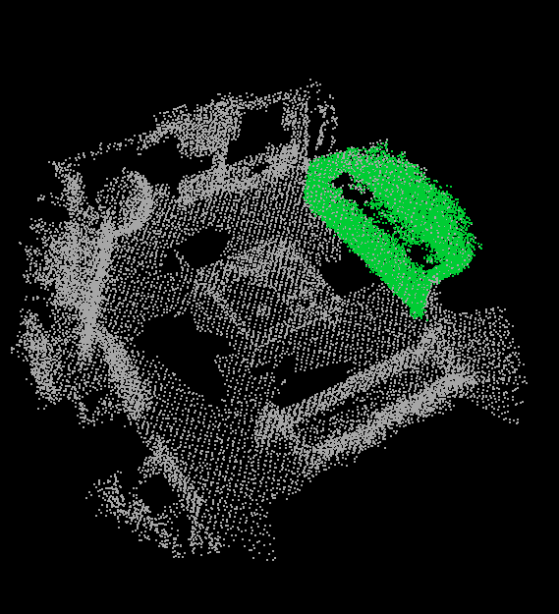
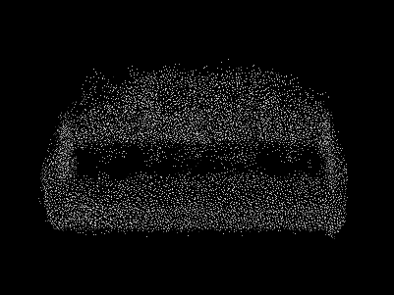
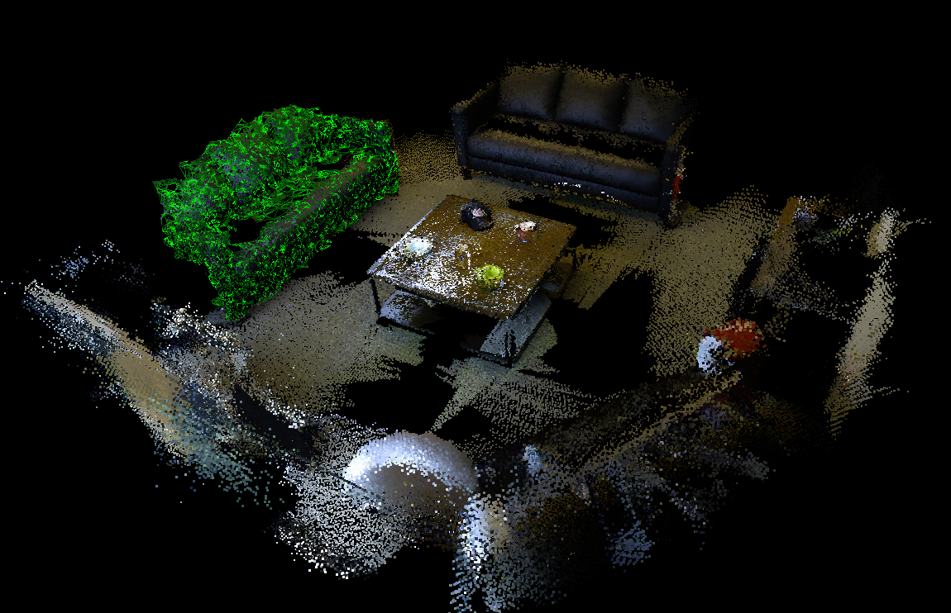
Registration on slam dataset - 1
Arbitrary SLAM Scene
PPF + ICP
Exact Sofa Model
Registered Pose

Slide 9
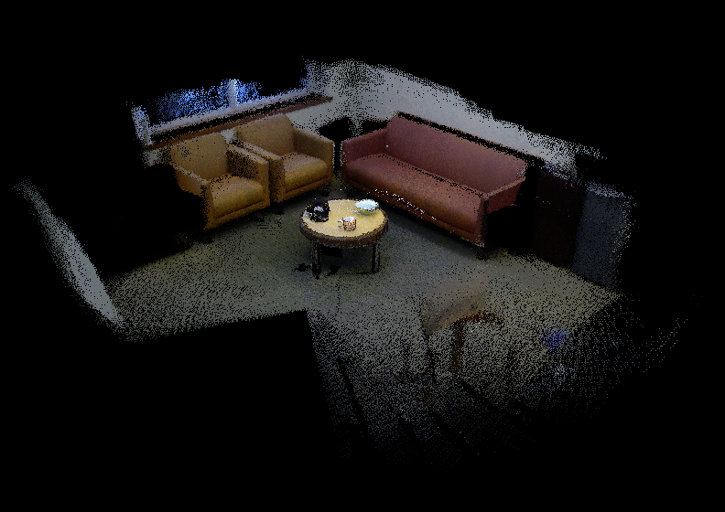
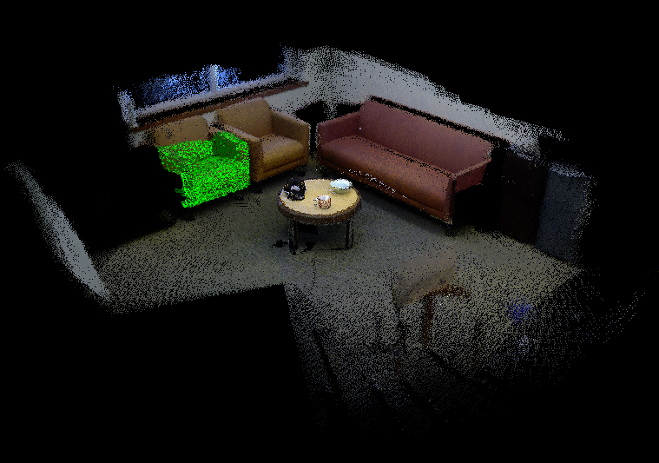
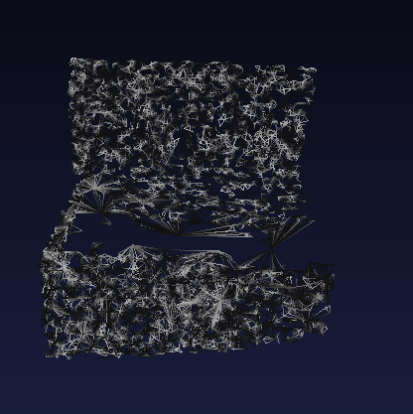
Registration on slam dataset - 2
3D Reconstruction
PPF + ICP
Model Matched to Reconstruction
Cropped & Processed Chair Model

Slide 10
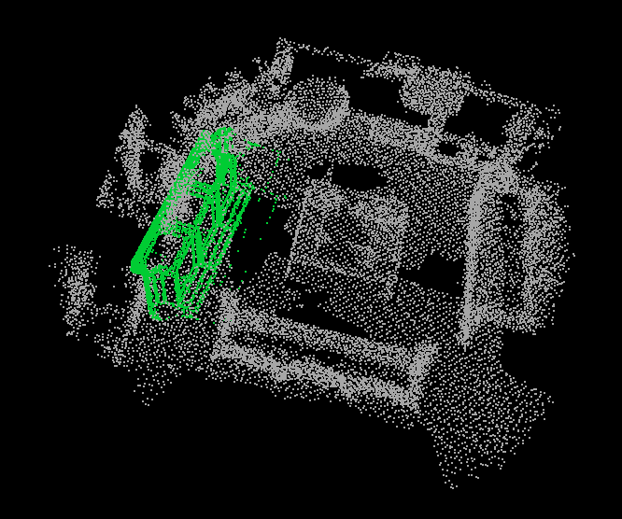
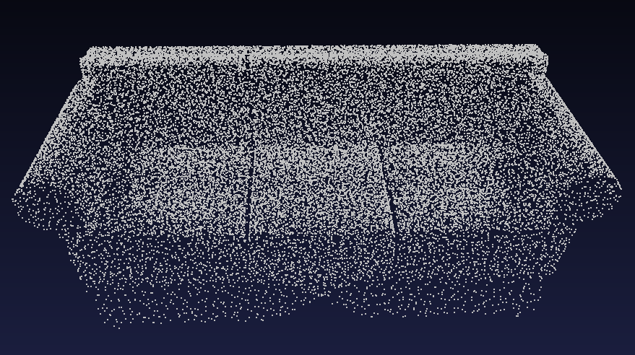
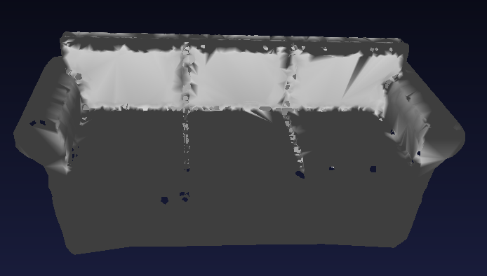
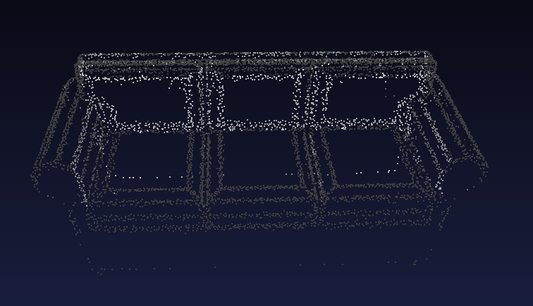
Failing cases
1
Model is Positioned with Error
4
Arbitrary Sofa Model
Train & Match
2
Non-Uniform Sampling & Normals Computation
3
Scaled and ReMeshed

Slide 11
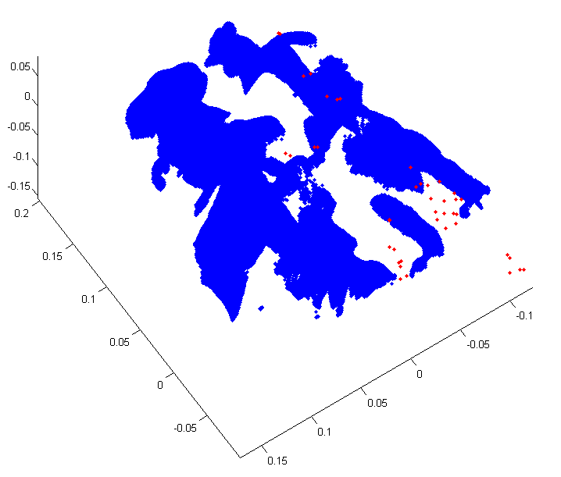
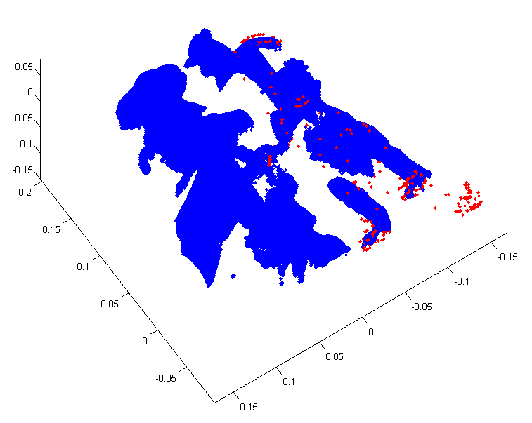
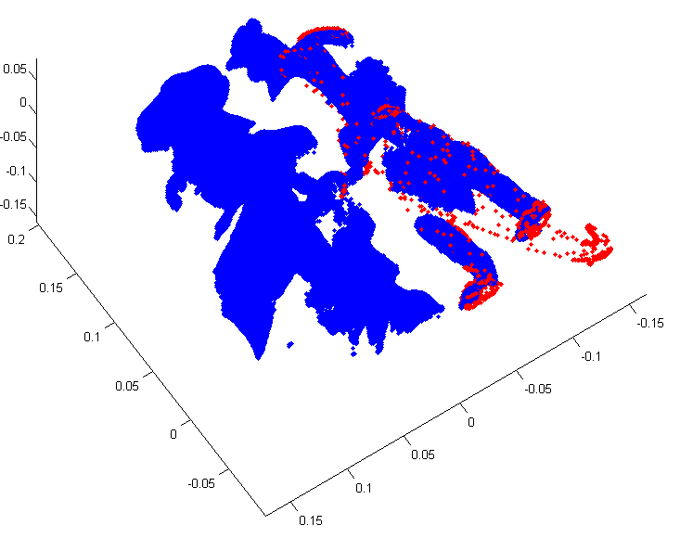
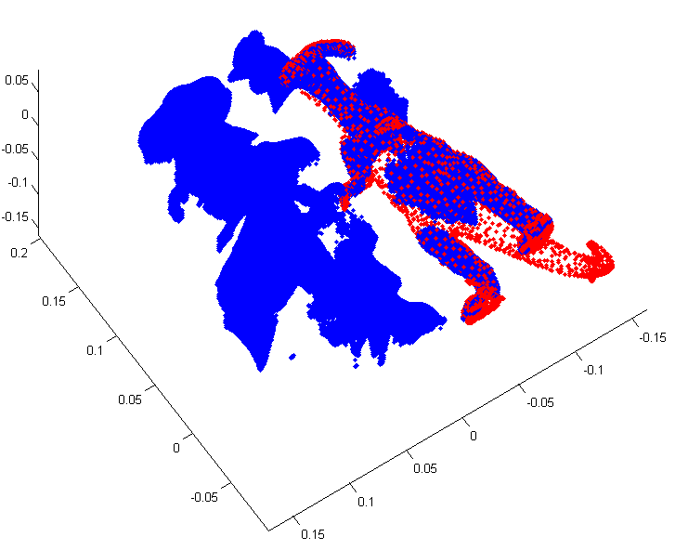
FAST ICP REGISTRATION
Point Cloud Normalization
Robust Registration: Median Absolute Deviations
Coarse to Fine Registration
Linearized Point to Plane Metric
Duplicate Assignment Resolution: Picky ICP
Registration in ~300 ms
Coarsest Level
Finest Level

Slide 12
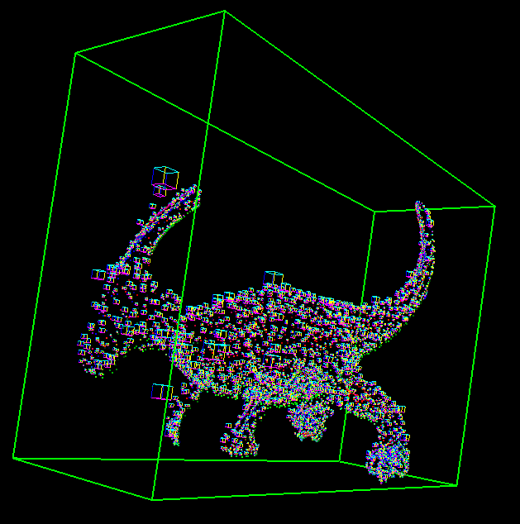
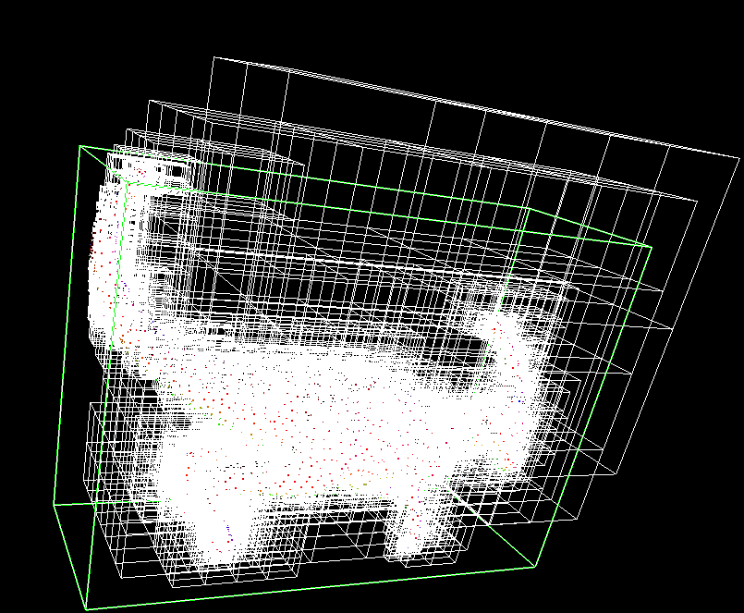
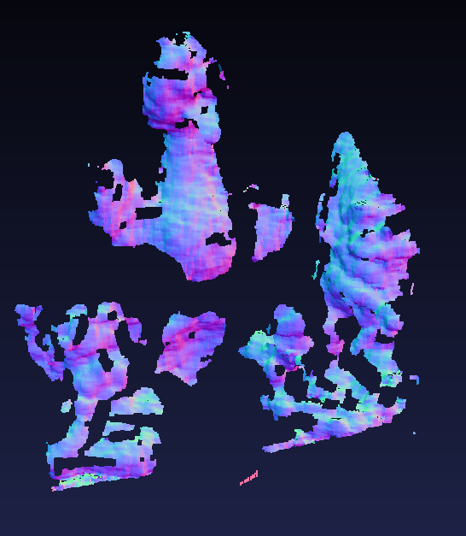
OTHER GAINED FUNCTIONALITIES
Bounding Boxes
Voxel Based Quantization of Point Clouds
Fast Normal Computation of Point Clouds
PLY Reading / Writing
Naïve Hashtable and Various Hashfunctions
PC Normals
Octrees

Slide 13

references
Many thanks to OpenCV Team and Google for makıng this an ingenious experience.

